Slide 1
Machine Intelligence CMP4010 Course Information and Logistics
Dina Elreedy

Slide 2
Course Instructors
Dr. Dina Elreedy
Email: dinaelreedy@eng.cu.edu.eg
dinaelreedy@gmail.com
TA:
Eng. Yahia Zakaria

Slide 3
Course Textbook
Artificial Intelligence, A Modern Approach S. Russell and P. Norvig , Prentice Hall 2010 Pearson Edu (3rd Ed.)
Please read the textbook chapters! ☺

Slide 4
Course Contents
Intelligent Agents
Search
Constraint satisfaction problems
Games
Markov decision process
Reinforcement Learning
Bayesian Networks
Decision Making

Slide 5
Intended Learning Outcomes
B.2 Design, model and analyze intelligent agents
B.4 Estimate and measure the performance
C2.1 Analyze, evaluate, select design and develop hardware and software platforms suitable for intelligent applications.

Slide 6
Blackboard
We will use blackboard for course materials, announcements,…etc.
Please enroll yourself in the course as a student.

Slide 7
Grading
Marks : 150 ( Year-work=60, Final exam=90 )
Year-work ( Programming Assignments, research assignment and quizzes (40), Midterm 20)

Slide 8
Grading policy
No cheating!!
If you copy from any source or from each other, you will be heavily penalized (You will receive in the assignment, and if it is repeated, you will receive in the year-work grades).
No late delivery!

Slide 9
Lectures
Please do not use a phone or laptop in the lecture.
No side talks ☺

Slide 10
Covid-19 Regulations
You must wear a mask in the lecture.
If you have any symptoms, please isolate yourself, and we can make-up any quizzes, assignments, lectures, your health comes first ☺
And please follow the faculty regulations procedure:

Slide 11
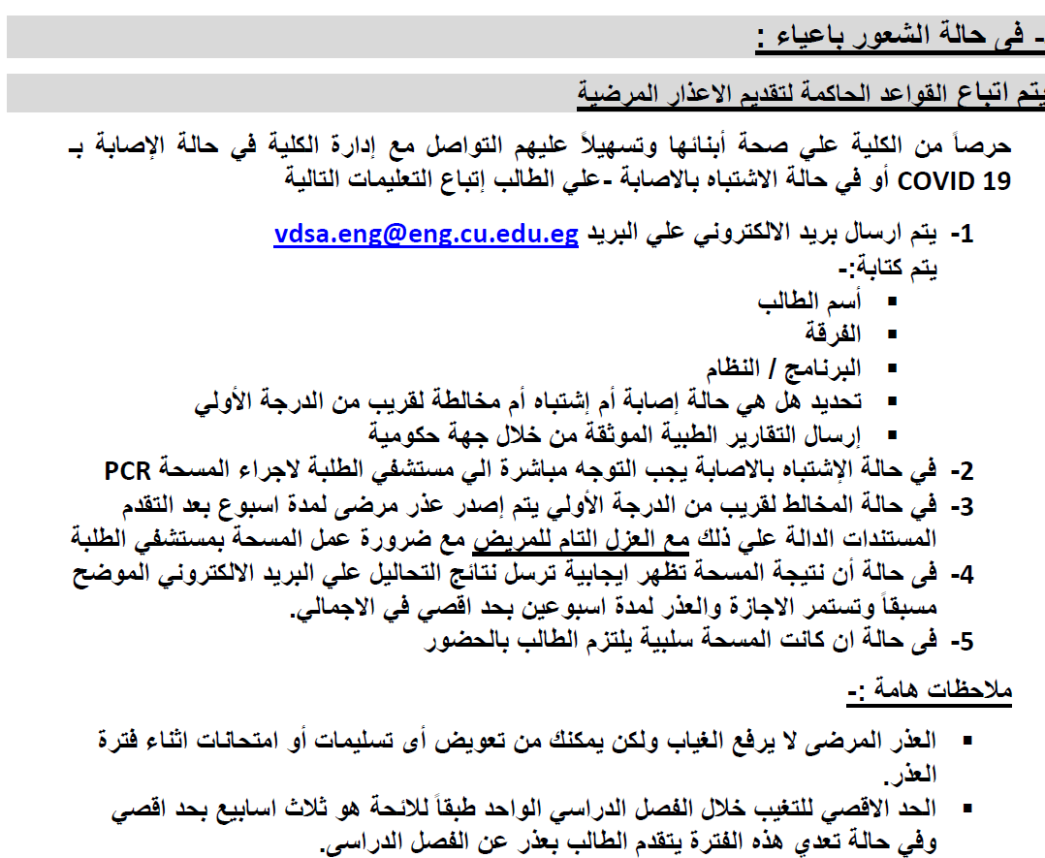
Covid-19 Faculty Regulations

Slide 12
Acknowledgment
The course slides are mainly adopted from the course textbook and AI Berkeley course notes.

Slide 13
Thank you
Wish you a happy semester
Enjoy Learning ! ☺

